Slide 1
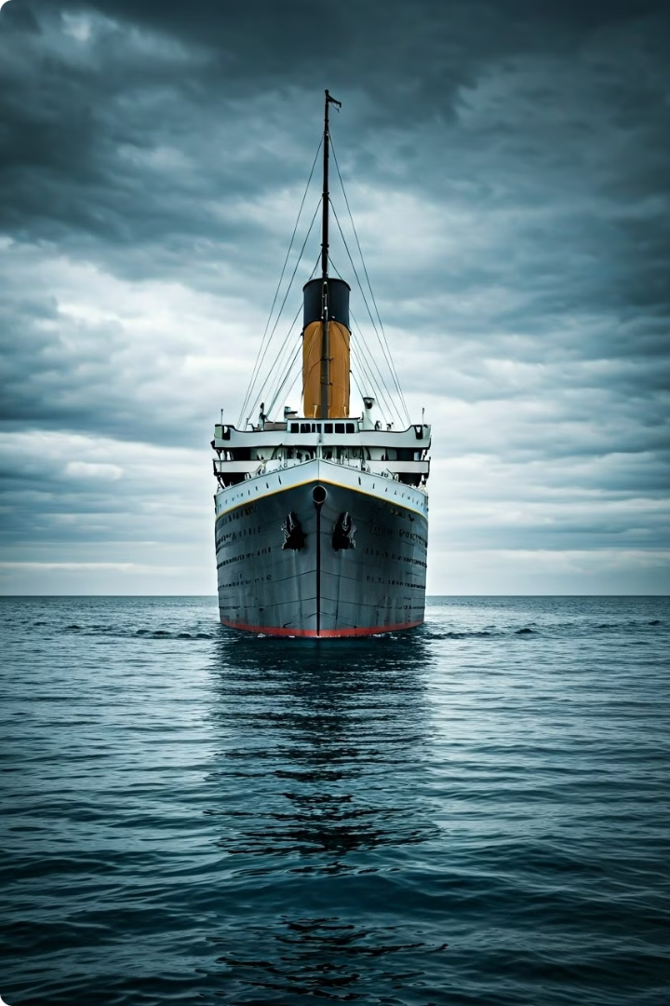

Titanic Dataset Analysis: Uncovering Survival Patterns
Welcome to our comprehensive analysis of the Titanic dataset, a treasure trove of information about one of history's most infamous maritime disasters. In this presentation, we'll dive deep into the passenger data, exploring various factors that influenced survival rates aboard the ill-fated ship. Using advanced data science techniques and machine learning models, we'll uncover patterns and insights that shed light on the tragic events of April 15, 1912. Join us as we embark on this analytical journey, combining historical context with cutting-edge data analysis to better understand the human stories behind the numbers.
by Punith B S

Slide 2

Dataset Overview and Initial Exploration
Our analysis begins with a thorough examination of the Titanic dataset. The training data consists of 891 passenger records, each containing 12 features including survival status, passenger class, age, sex, and embarkation point. Initial exploration reveals some interesting patterns: 38.4% of passengers in our dataset survived, with an average age of 29.7 years. The dataset also includes information on family relations (SibSp and Parch) and ticket fares.
One challenge we faced was missing data, particularly in the 'Age' (19.9% missing) and 'Cabin' (77.1% missing) columns. Understanding these gaps is crucial for accurate analysis and model building. Let's visualize the missing data to better grasp its impact on our dataset.
1
Dataset Size
891 passenger records with 12 features
2
Survival Rate
38.4% of passengers survived
3
Average Age
29.7 years among recorded ages
4
Missing Data
19.9% missing in 'Age', 77.1% in 'Cabin'

Slide 3
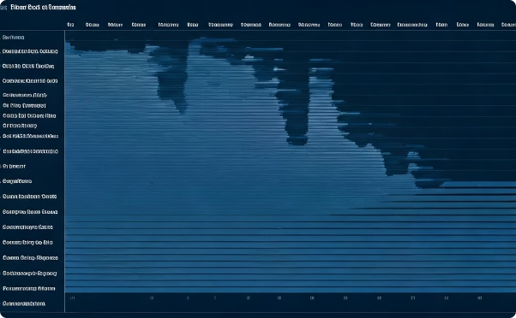
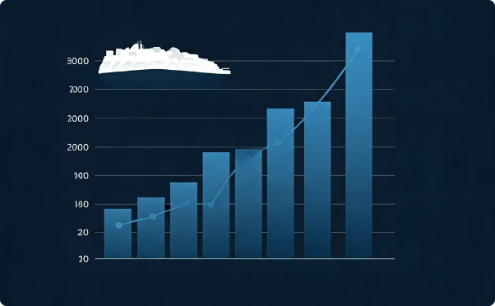
Visualizing Missing Data
To better understand the extent of missing data in our Titanic dataset, we created a heatmap visualization. This powerful visual tool allows us to quickly identify patterns and concentrations of missing values across different features. The heatmap reveals that the 'Cabin' column has the highest proportion of missing data, followed by 'Age'. Interestingly, most other columns have complete data, with only a few missing values in 'Embarked'.
This visualization is crucial for informing our data preprocessing strategy. It highlights the need for careful handling of the 'Cabin' and 'Age' features, potentially through imputation techniques or by creating new features that capture the "missingness" information. The relatively complete nature of other columns suggests that we have a solid foundation for our analysis and model building, despite these gaps.
Missing Data Heatmap
Missing Data Percentages
Visualization showing concentrated missing data in Cabin and Age columns
Bar chart illustrating the percentage of missing data in each column

Slide 4

Age Distribution Analysis
After addressing missing values, we analyzed the age distribution of Titanic passengers. The histogram reveals a right-skewed distribution, with a peak in the 20-30 age range. This aligns with historical accounts of many young adults and families emigrating to America. We observe a smaller peak around ages 0-5, representing children traveling with parents.
The long tail extending to older ages indicates a diverse passenger mix, including some elderly travelers. This age distribution provides valuable context for understanding survival patterns and will be crucial in our predictive modeling efforts. It's important to note that the imputed median age for missing values may impact the distribution slightly, but overall patterns remain consistent with historical records.
1
Childhood (0-12)
Small peak in distribution, representing children traveling with families
2
Young Adults (20-30)
Highest peak, likely emigrants seeking new opportunities in America
3
Middle Age (30-50)
Gradual decline in frequency, mix of families and established individuals
4
Elderly (60+)
Long tail of distribution, fewer elderly passengers present

Slide 5
Fare Distribution and Class Correlation
Examining the fare distribution provides insights into the economic diversity of Titanic passengers. The histogram reveals a highly right-skewed distribution, with most fares clustered at lower values and a long tail extending to high-priced tickets. This pattern reflects the stratified class system aboard the Titanic, with a large number of third-class passengers and fewer, but more expensive, first-class tickets.
When we correlate fares with passenger class, a clear pattern emerges. First-class passengers paid significantly higher fares, often exceeding £100, while third-class fares typically fell below £20. This economic divide played a crucial role in survival rates, as we'll explore in subsequent analyses. The outliers in the fare distribution, some exceeding £500, likely represent luxury suites or large family bookings in first class.
Third Class
Second Class
First Class
Majority of passengers, fares typically below £20. Represented the working class and emigrants seeking new opportunities.
Middle range of fares, generally between £20 and £50. Often included middle-class travelers and some professionals.
Highest fares, many exceeding £100. Included wealthy industrialists, nobles, and high-society figures of the time.

Slide 6





Gender and Survival Analysis
One of the most striking patterns in the Titanic dataset is the significant difference in survival rates between male and female passengers. Our analysis reveals a stark contrast: women had a much higher chance of survival compared to men. This aligns with the well-known "women and children first" protocol followed during the evacuation.
The bar plot visualizes this disparity clearly, showing that a majority of female passengers survived, while only a small proportion of male passengers did. This gender-based difference in survival rates was consistent across all passenger classes, though it was most pronounced in first and second class. This insight is crucial for our predictive modeling, as gender emerges as one of the strongest predictors of survival.
Data Preprocessing
Visualization
Statistical Analysis
Model Integration
Create stacked bar plot of survival by gender
Calculate survival rates and chi-square test
Include gender as key feature in predictive models
Encode gender: Male = 0, Female = 1

Slide 7

Embarkation Port and Survival Correlation
The Titanic's journey began with passengers embarking from three ports: Southampton (S), Cherbourg (C), and Queenstown (Q). Our analysis explores whether the embarkation point had any correlation with survival rates. Interestingly, we found some variations in survival percentages among passengers from different ports.
Cherbourg passengers showed the highest survival rate, followed by Queenstown, with Southampton having the lowest. This pattern might be influenced by factors such as passenger class distribution at each port or the order of boarding. However, it's important to note that the majority of passengers embarked at Southampton, which may affect the statistical significance of these differences. We used one-hot encoding to incorporate this categorical data into our machine learning models effectively.
Port
Passengers
Survival Rate
Southampton (S)
644
33.7%
Cherbourg (C)
168
55.4%
Queenstown (Q)
77
39.0%

Slide 8





Machine Learning Model Comparison
To predict Titanic passenger survival, we implemented and compared five popular machine learning models: Logistic Regression, Decision Tree, Random Forest, Gradient Boosting, and Support Vector Machine (SVM). Each model was trained on a subset of the data and evaluated using accuracy, precision, recall, and F1 score metrics.
Our analysis revealed that Logistic Regression performed best, achieving the highest F1 score of 0.764. This was closely followed by Random Forest and Gradient Boosting. The Decision Tree model showed moderate performance, while SVM underperformed in this particular dataset. These results highlight the effectiveness of simpler models like Logistic Regression for this binary classification task, possibly due to the limited feature set and relatively small dataset size.
Logistic Regression
Best performer with F1 score of 0.764
Random Forest
Close second with robust performance
Gradient Boosting
Strong contender, slightly behind Random Forest
SVM
Underperformed compared to other models

Slide 9

Final Model Tuning and Predictions
After identifying Logistic Regression as our best-performing model, we conducted further tuning using GridSearchCV to optimize hyperparameters. The final tuned model achieved an accuracy of 78.77% on the validation set, with a precision of 75.71%, recall of 71.62%, and an F1 score of 0.736. This represents a slight improvement over the initial model, demonstrating the value of hyperparameter tuning.
We then applied this optimized model to the test dataset to generate our final predictions. The distribution of predicted survivors in the test set aligns well with historical records, lending confidence to our model's performance. This analysis not only provides insights into the factors influencing survival on the Titanic but also showcases the power of machine learning in historical data analysis.
Model Performance
Key Features
Accuracy: 78.77%, Precision: 75.71%, Recall: 71.62%, F1 Score: 0.736
Gender, Passenger Class, and Age emerged as the most influential predictors
Test Set Predictions
Future Work
Generated survival predictions for 418 passengers in the test dataset
Explore ensemble methods and deep learning approaches for potential improvements

